Slide 1
P230 Patient’s Condition Classification
Using NLP and Supervised ML Algorithms

Slide 2
Objective of the Project
To predict (or Classify) the Patient’s condition based on Reviews(input) Using NLP and Supervised ML techniques.
Recommending Medicines based on the predicted Condition.
There are 3 conditions(target) we need to classify i.e.
Depression
High Blood Pressure
Diabetes Type 2

Slide 3
Steps Followed:
Data Collection and Data Description
EDA Visualizations
EDA Summary
Text Preprocessing
Feature Extraction
Model Building and Models Summary
Sentiment Prediction for each Medicine for the recommendation
Final Deployment

Slide 4
Data Collection and Data Description
The data can be collected from the below two sources
UCI Machine Learning datasets
Kaggle website
Here the data set is provided to us directly and the dataset is named as drugsCom_raw.tsv

Slide 5
Data Description:
The dataset consists of 6 features i.e.
1. DrugName (categorical) → name of drug
2. condition (categorical) → name of condition
3. review (text) → patient review about the medicine
4. rating (numerical) → 10 star patient rating
5. date (date) → date of review entry
6. usefulCount (numerical)→ number of users who found review useful

Slide 6
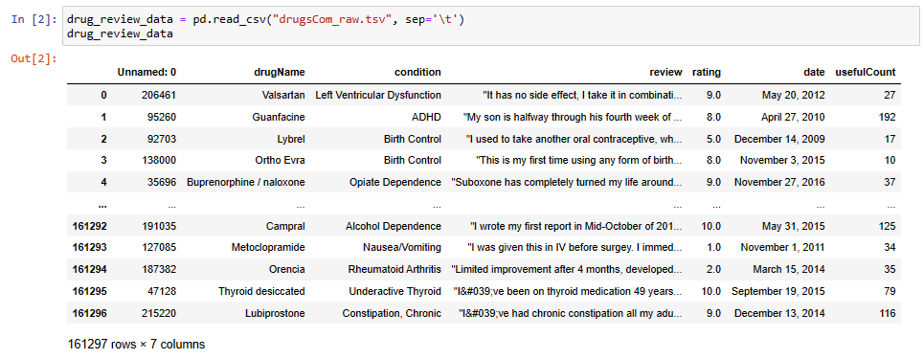
The original dataset consists of 161297 observations. Here the condition column has many conditions which includes our desired 3 conditions i.e. Depression, High Blood Pressure and Diabetes Type 2.

Slide 7
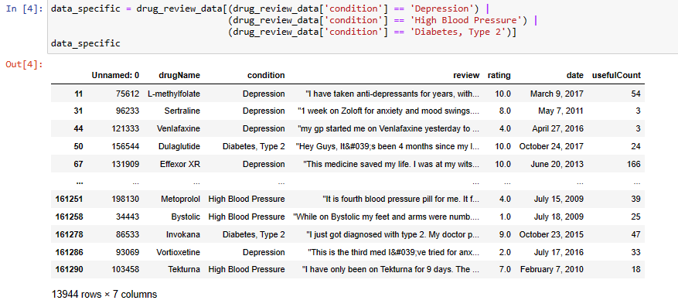
Extracting data with specific conditions (Depression, High Blood Pressure, Diabetes, Type 2) Here we have 13944 observations.

Slide 8
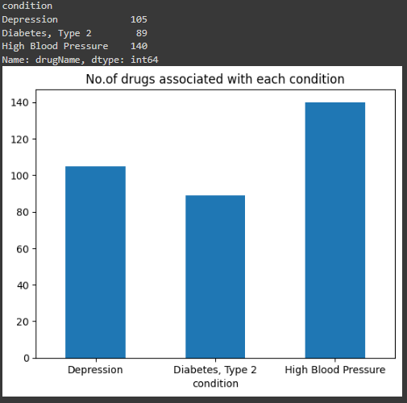
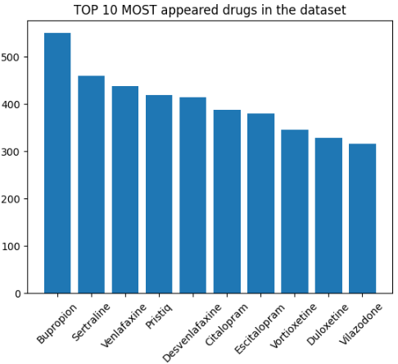
2. EDA Visualizations

Slide 9
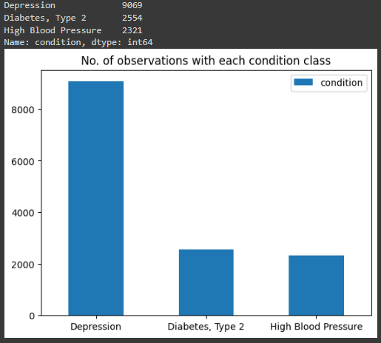
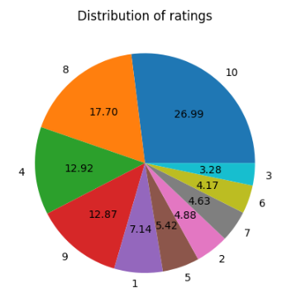

Slide 10
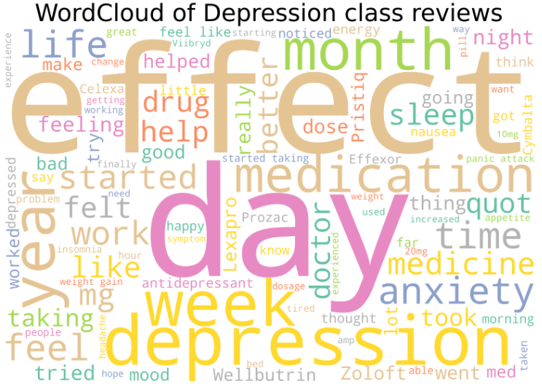
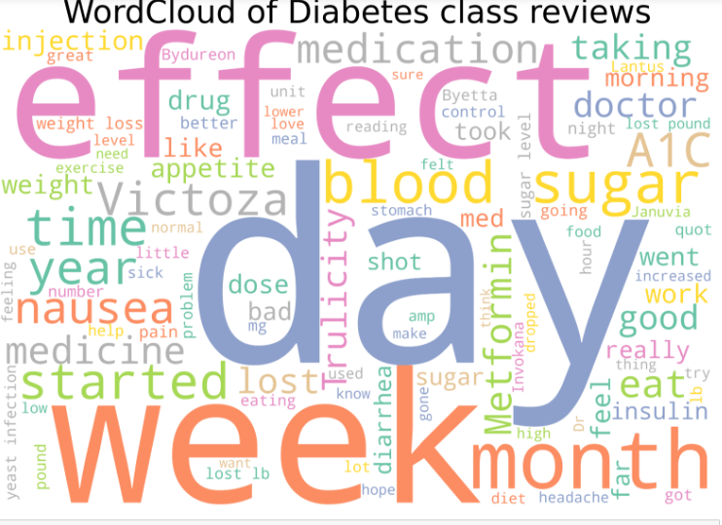

Slide 11
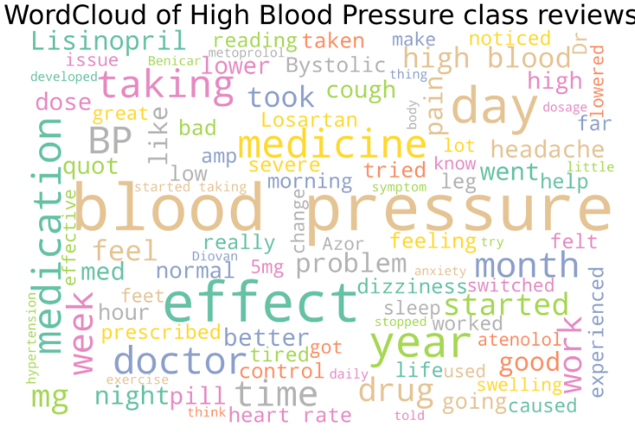
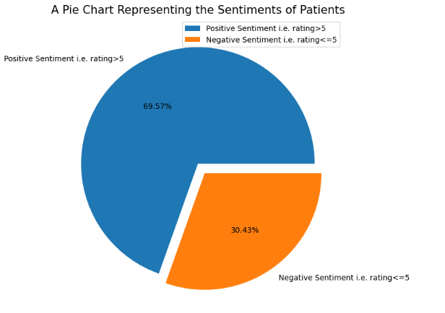
We showed only a few visualizations for the demo..we can do other visualizations also

Slide 12
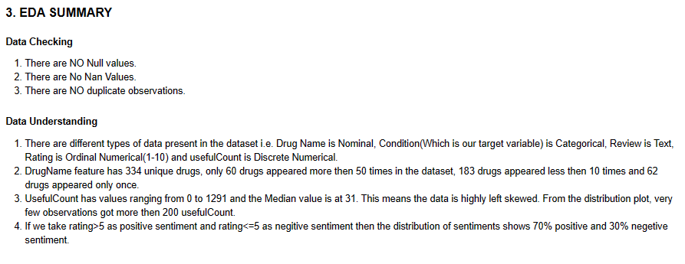

Slide 13
4. Text Preprocessing
In this step we performed text cleaning, it involves
Lowering the text
Removing stop words
Removing empty spaces and empty strings
Removing HTML tags and other related things
Removing special characters (?,!,# etc.)
Tokenization
Lemmatization
For this purpose we have used libraries like NLTK , re(Regular Expressions), string, BeautifulSoup, wordnetLemmatizer etc.

Slide 14
5. Feature Extraction
Two types of feature extractions methods we have used i.e.
BAG OF WORDS (with unigrams, bigrams and trigrams)
TF-IDF (Term Frequency - Inverse Document Frequency)
We have used countVectorizer,TfidfVectorizer from Sklearn library for feature extraction.

Slide 15
6. Model Building and Model Summary
To build the model, we used the extracted features as our input and the condition as our target variable.
Then we splitted the data into train(80%) and test data(20%).
As we know condition has 3 classe i.e. Depression, Diabetes Type 2 and High Blood Pressure. We trained different classification ML models to fit the train data.
We used the test data to find the performance of the models. We used F1-score for the final model selection.
Here we used mostly sklearn, TensorFlow and Keras to build the Models.

Slide 16
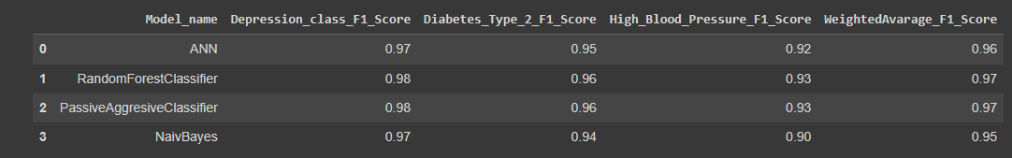
Model Summary table:
Random Forest and Passive Aggressive have same weighted F1-scores, we can choose any one, we took RandomForestClassifier as our final model.
Then we saved the trained model for the Deployment.

